Slide 1
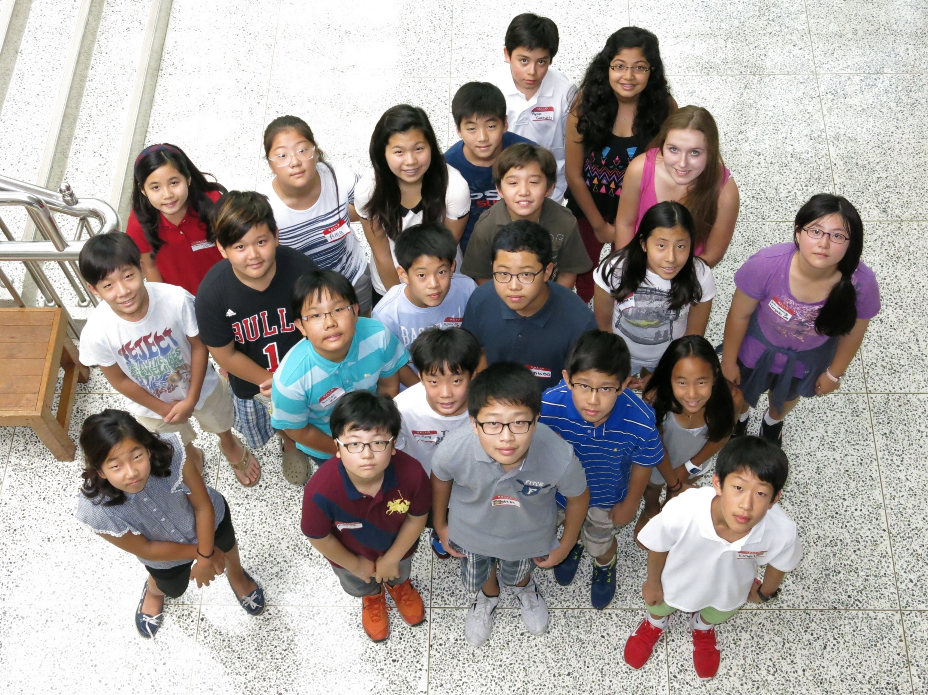
NEW STUDENTS!

Slide 2
Welcome, New Parents!
Introduction of Office Personnel and PTA
Communication
Transitions
After-School Activities
MAP Testing
Grade Reporting
Student Portfolios
Q & A

Slide 3
Communication
Phone Mrs. Woo or Miss Lee: 330-3241 or, from a mobile, 02-330-3241
Office Emails:
lgaylord@seoulforeign.org jhill@seoulforeign.org dswanson@seoulforeign.org hswoo@seoulforeign.org
Teacher emails (particularly the Advisor): get these at Back To School Night!

Slide 4
Communication
PowerSchool (ps.sfs.or.kr) for updating contact info and checking grade reports
www.seoulforeign.org for general information, particularly the Middle School pages
Edmodo.com for announcements, a calendar specific to your child’s classes, and direct communication with the teacher
Social Media

Slide 5
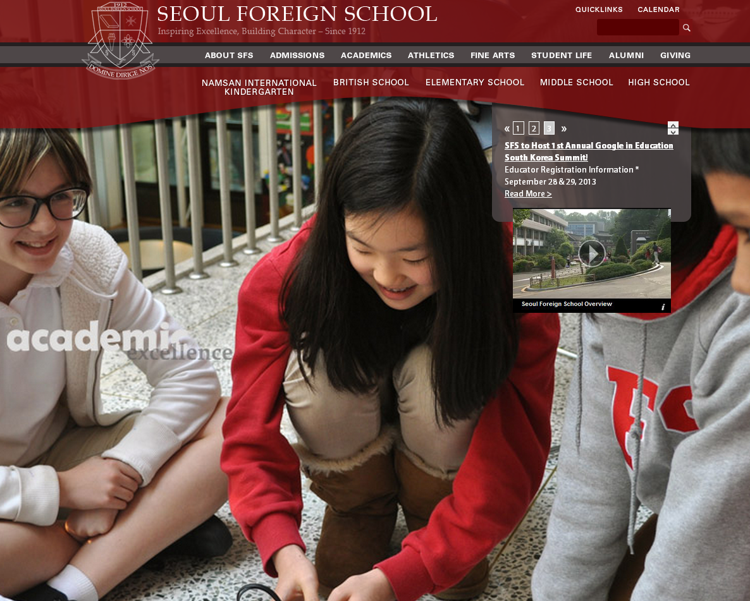

Slide 6
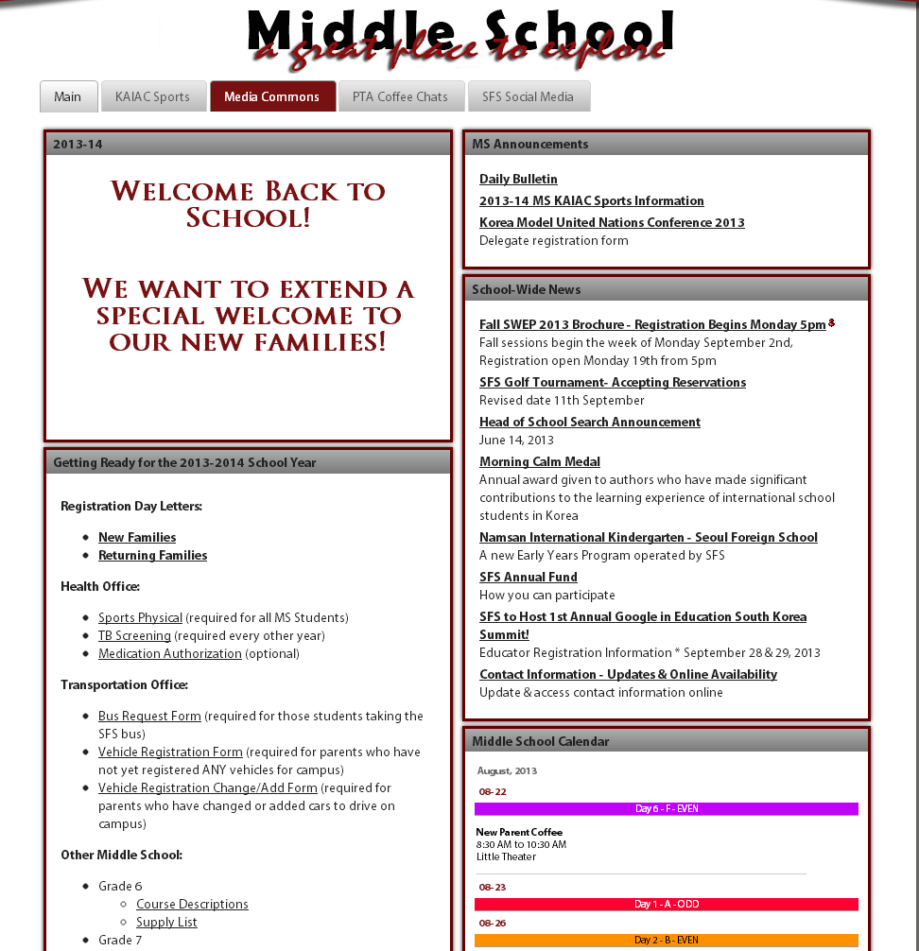

Slide 7
Communication
Student Handbook/Planner
The handbook is for parents too!
Please note! The Odd and Even day designations in the Student Planner are wrong! Please use the SFS wall calendar to whether the MS has an Odd or Even day.

Slide 8
Transitions
How are YOU doing?

Slide 9
After-School Activities
SWEP – School Wide Extracurricular Program
KAIAC – Korean-American Interscholastic Activities Conference
Sports (sign up through SWEP)
Arts (no need to sign up, handled in classes)
Spelling Bee (details will be announced in the spring)

Slide 10
After-School Activities
Other Activities:
Musical “Into the Woods” (by audition)
Jazz Band and Jazz Ensemble (by audition)
Aquatics
Yearbook
Student Senate
Tech Crewsaders

Slide 11
After-School Activities
Tuesday Activities:
Extra Help from 3-4pm
Discipleship* from 4-5pm
Praise Band*
IMPACT and IMPACT Leaders
*Applications in MS Office

Slide 12
After-School Activities
Staying after school
Generally only for supervised activities
Green zones when not in the activity
Green passes for special circumstances
Late buses only for those in activities

Slide 13
Measures of Academic Progress
MAP Testing will run through most of September and be repeated in January and April.
Adaptive, computer-based testing that helps teachers monitor growth and particular needs in Mathematics, Reading, and Language Usage.

Slide 14
Grade Reporting
Achievement Scales - 0-100 or E,S,N
Citizenship Scale – 1 to 4
Gradebooks will open to parents at mid-trimester (ps.sfs.or.kr)
Mid-trimester online progress checks and trimester printed report cards

Slide 15
Student Portfolios
Students will showcase their learning by posting reflections and evidence from learning experiences.
Coordinated in Advisory classes.
Electronic format, web-based.
We hope parents will check these periodically.

Slide 16
Thank you for choosing Seoul Foreign School! We are delighted that you and your children have joined our learning community. Middle School Back To School Night is on Sept 4, 6:30-9:15 PM (just for parents)

